Slide 1

ClaritEar -
14th April 2016
Group 6 : Haming
Members :
Muhamad Harist Refian Anwar
Andira Rozawati
Pandu Wicaksono

Slide 2
What is ClaritEar ?
ClaritEar (/ˈklær.ə.tɪər/) is an educational and entertainment applications based on Android that are useful to train your hearing sensitivity in knowing the kind of tone or chord that is being played. ClaritEar’s logo :

Slide 3
GOAL OF THIS PROJECT
Educate user by training their hearing to recognizing all types of chords
Entertain user by giving them apportunity to compete with other user

Slide 4
Application’s Feature
The features from our application that will be created are:
Produce some sounds from several original musical instruments, so the player can find out which tone or chord is being played.
Compete with other players online.

Slide 5

INNOVATION
There will be some innovations that may be implemented into our applications that we're working on, including:
Directly challenge other players by using the internet.
Learn some musical instruments online.
Share and publish your achievements on social media.

Slide 6
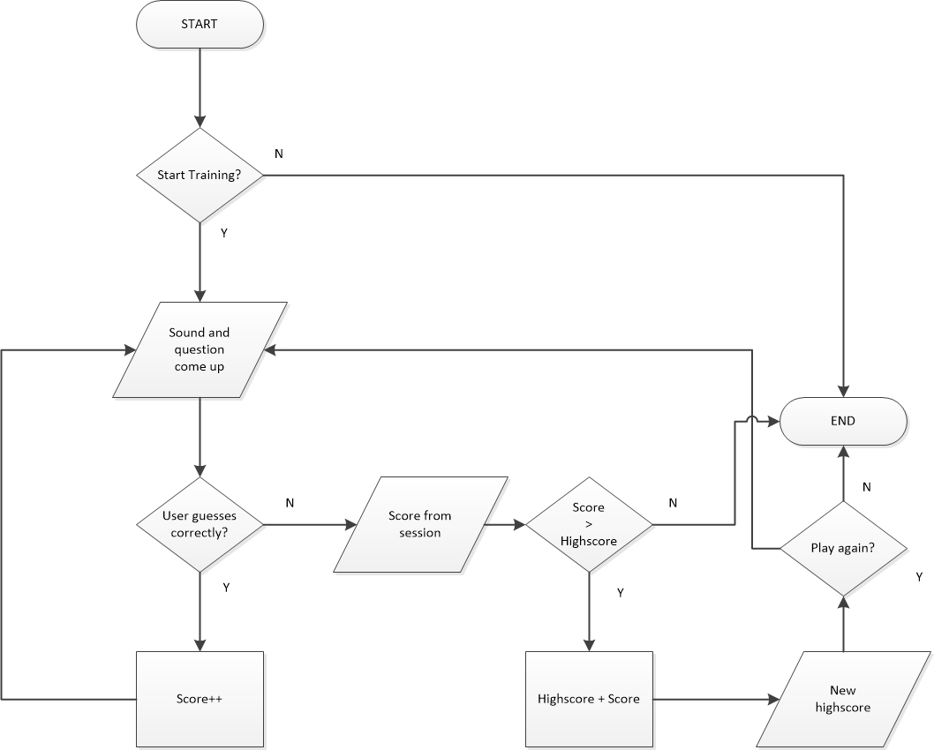
Flowchart
The flowchart will explain how ClaritEar Works

Slide 7









Tools That We Gonna Use :

Slide 8
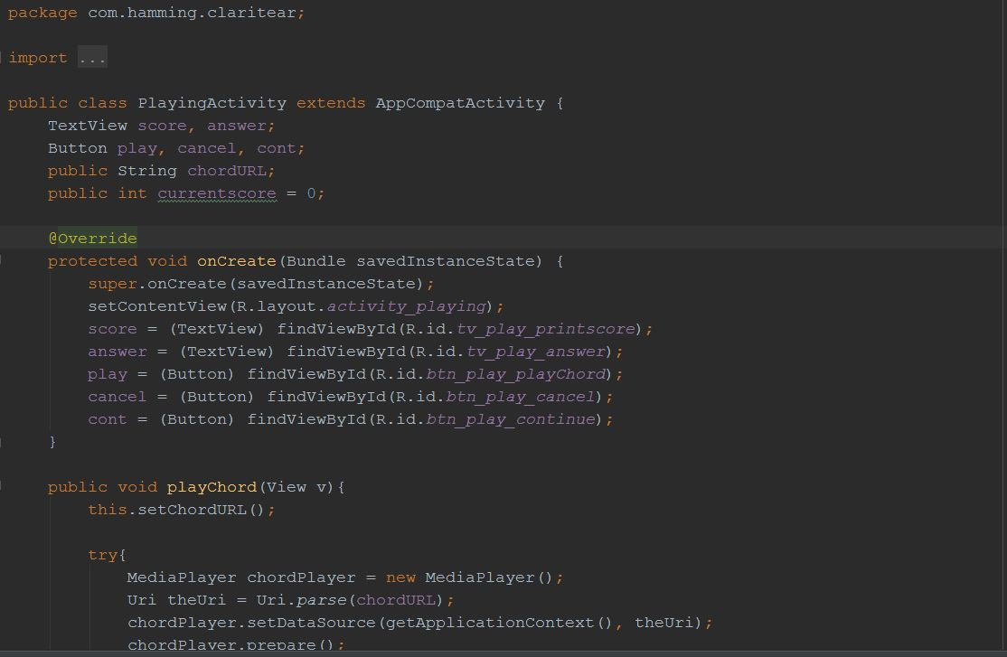
Programming Language
Java – Android Studio

Slide 9
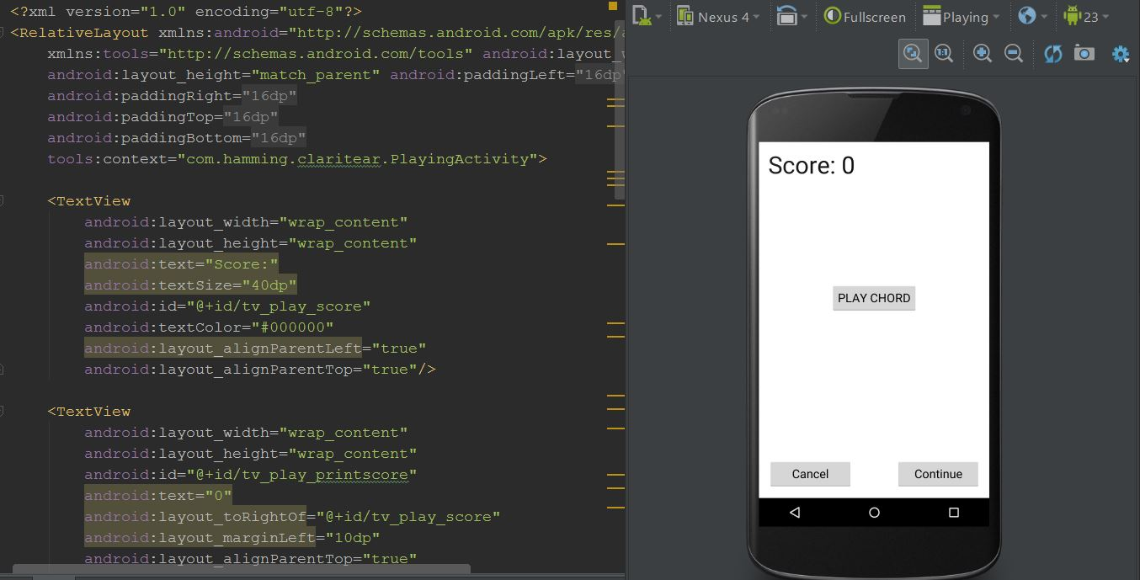
Programming Languange
XML – Android Studio
Design User Interface

Slide 10
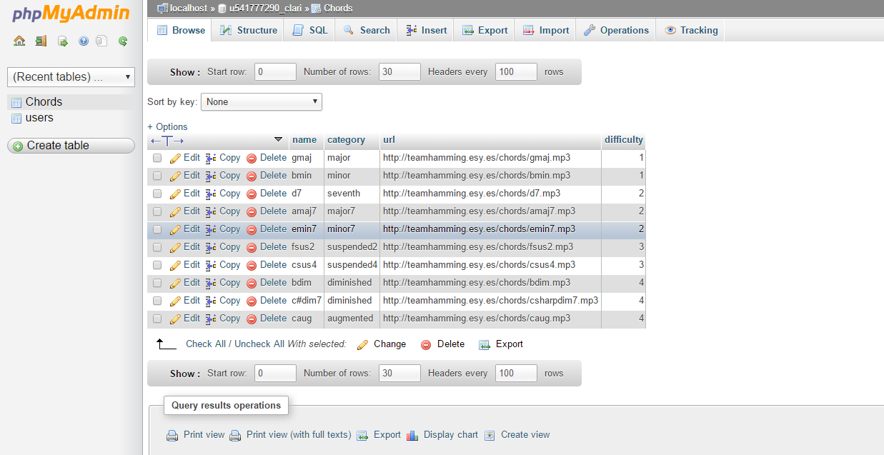
Database

Slide 11
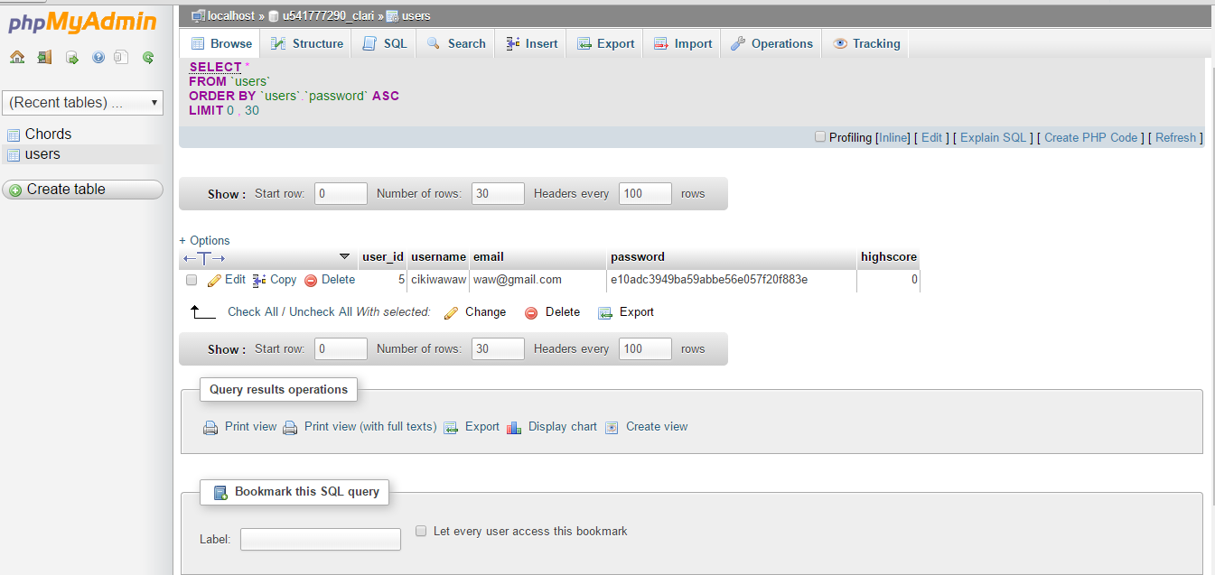
Database

Slide 12
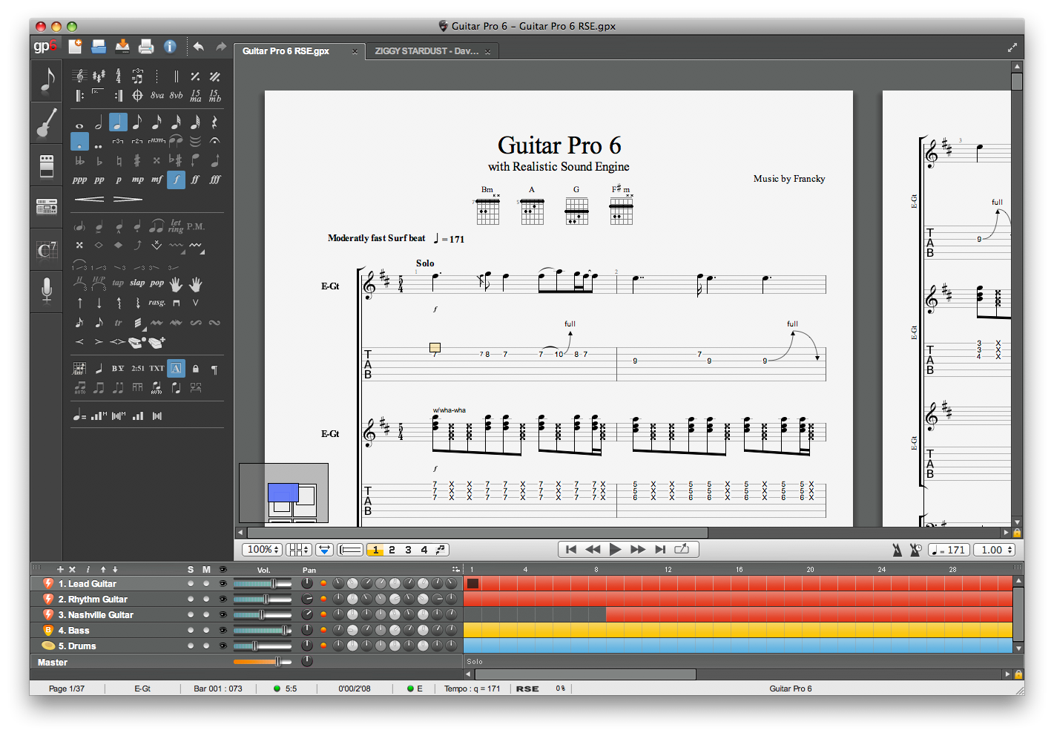
Guitar Pro

Slide 13
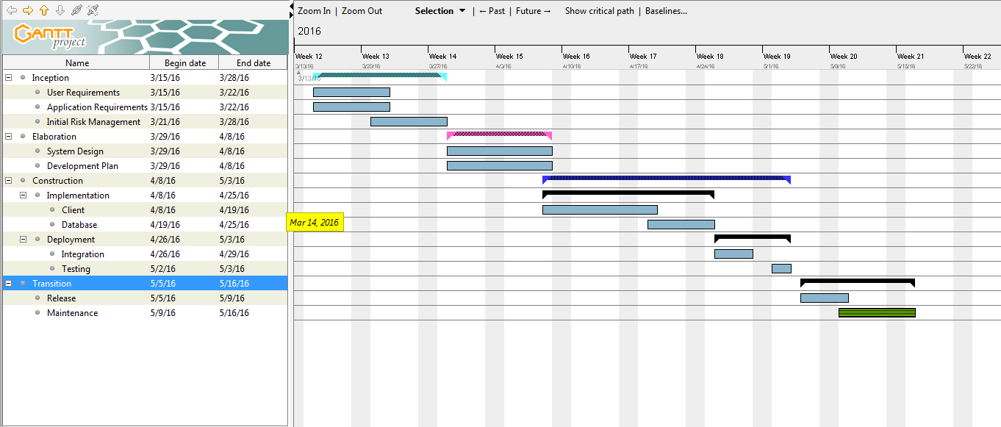
SCHEDULE

Slide 14
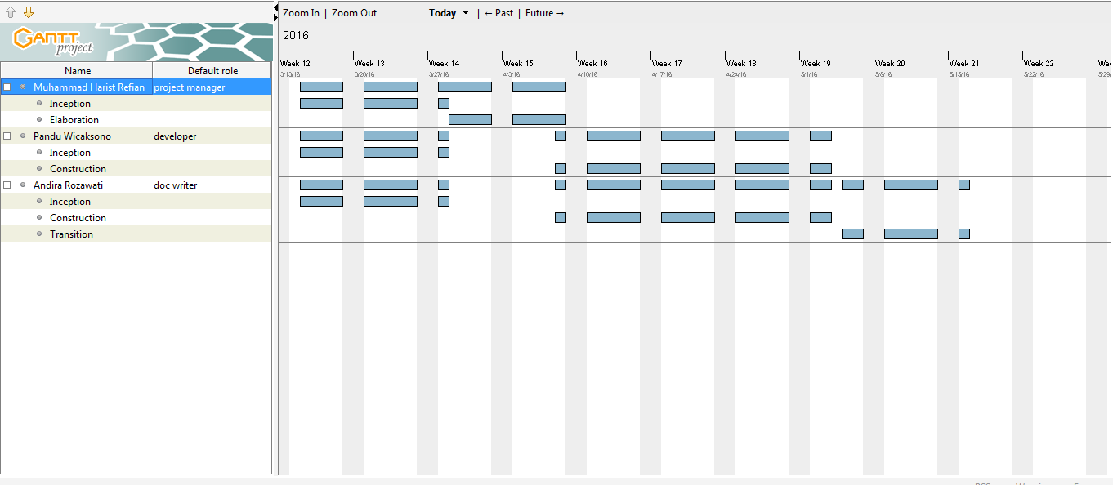
Resources Chart

Slide 15
Thank You For Your Attention ! ☺

